Slide 1
Software Engineering and Agile
Sailesh A Padmanabhan

Slide 2

Software Engineering
Software Engineering is an engineering branch related to the evolution of software product using well-defined scientific principles, techniques, and procedures. The result of software engineering is an effective and reliable software product.

Slide 3

Software Engineering as per IEEE
The application of a systematic, disciplined, quantifiable approach to the development, operation, and maintenance of software; that is, the application of engineering to software
Fritz Bauer, a German computer scientist, defines software engineering as: “Software engineering is the establishment and use of sound engineering principles in order to obtain economically software that is reliable and work efficiently on real machines.”

Slide 4

Need of Software Engineering
The need of software engineering arises because of higher rate of change in user requirements and environment on which the software is working. Following are some of the needs stated
Large software - It is easier to build a wall than a house or building, likewise, as the size of the software becomes large, engineering has to step to give it a scientific process
Scalability- If the software process were not based on scientific and engineering concepts, it would be easier to re-create new software than to scale an existing one
Cost- As hardware industry has shown its skills and huge manufacturing has lower down the price of computer and electronic hardware. But, cost of the software remains high if proper process is not adapted.

Slide 5
Need of Software Engineering
Dynamic Nature- Always growing and adapting nature of the software hugely depends upon the environment in which the user works. If the nature of software is always changing, new enhancements need to be done in the existing one. This is where the software engineering plays a good role.
Quality Management- Better process of software development provides better and quality software product
Caption Lore Ipsum

Slide 6
A Formal Definition of Software Engineering
An organized, analytical approach to the design, development, use, and maintenance of software.” More intuitively, software engineering is everything you need to do to produce successful software. It includes the steps that take a raw, possibly nebulous idea and turn it into a powerful and intuitive application that can be enhanced to meet changing customer needs for years to come

Slide 7
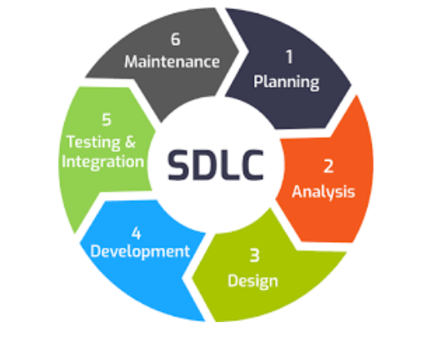
Software Development Life Cycle

Slide 8
SDLC Stages
Planning
Analysis
Design
Development
Testing and Integration
Deployment and Maintainence

Slide 9
Planning Stage
Planning stage involves creating scope of application ,financial as well as technical, how many people to involve ,skills required, budget for entire project ,duration in which all the process has to be completed and software to be handed over to the client At the planning stage itself certain key issues are discussed with the team
• Objective of intended software system
• different stake holders have to be identified ,
• role of each person involved with the process of development ,
• financial limitations with the team and customer
• Business risk involved
Planning process can include discussion with stake holders ,and team that is going to develop the software
Notes:
Who Is Considered a Stakeholder?
While every development project is unique, there are some universal categories that can be used to guide stakeholder identification.
End users and beneficiaries
These are the people who will be most directly affected by the software. Their buy-in is essential. No matter how flashy or efficient software is, if end users don’t like it they won’t use it. End users fall into three main groups:
Direct users Those who will use the software directly are usually most concerned with how it will fit into their current workflows. They want to know that it solves a significant problem or otherwise makes their job easier.
Secondary users
Direct users interact with the software itself. Secondary users rely on the products of the software. New software needs to produce results in a format that fits into secondary users’ workflows. Forgetting about this group can cause one problem while solving another, like suddenly generating reports in a format secondary users can’t integrate into their analytics.
Beneficiaries These are all the people affected by the software’s products. The term encompasses a huge base of customers and vendors who focus more on results than process. Their input should revolve around the services or information the software will provide.

Slide 10
Analysis Stage
At this stage all the requirements related to develop the software are gathered ,analyzed and discussed with team and stake holders
Gathering requirements ,involves talking to stake holders and understanding complete requirement of users
Consultation can be made with a domain expert of different people involved currently in the existing process
A complete analysis and feasibility report ,metrics and analysis documents form critical part of development process ,as they can be accessed anytime to take a design decision, check deviation from intended objective , analyze what is possible within available resources and what exactly the customer wants

Slide 11
Design Phase
This phase involves design the actual system that needs to be developed .Designing can involve different methodologies like creating a map of the system ,use cases ,UML Diagrams ,developing prototypes .
The purpose of this phase is to ensure that all requirements analyzed during requirement analysis phase are finally filtered and put on paper ,or prototyped and the team can visualize the final outcome that they will get once the development process is over

Slide 12
Development Phase
In this phase ,the software that has been designed is put to code .Different programming languages and technologies can be used for coding ,
This depends on methodology to be used for programming .Two popular methodologies are procedural and Object Oriented programming Most of the time it is decided at the design stage itself ,which methodology has to be used to code for intended software system.
Systems are mostly developed today around Object Oriented Programming
Different programming languages that target Object Oriented Programming are C++,Java,C#

Slide 13
Testing and Integration phase
This phase involves testing of system developed.
The objective of testing is to identify bugs and issues in the system.
Is the intended system as per requirements or has it deviated from the intended purpose .
The intention of testing is not to stall the development process ,or negate the system built ,but to identify bugs that can damage the hole process of development .
The testing process has it’s own lifecycle called software testing life cycle

Slide 14
Deployment and Maintenance
The system developed through the software development process has to be delivered to the client ,either as a package if it is a desktop application ,or through different stores ,if it is a mobile application or through web it is a web application
Maintenance involves different things like
• updating software from time to time
• providing patches to plug undetected bugs
• cleaning up unwanted data collected through interaction of user with software
• monitoring software for security related risks
• scaling application to meet increasing customer demand
• enhancing security needs

Slide 15
Development Model
The six stages of software development appear based on type of model selected for development
different models that can be used to implement are Waterfall model, Spiral Model ,Win-Win Spiral model ,agile development model

Slide 16
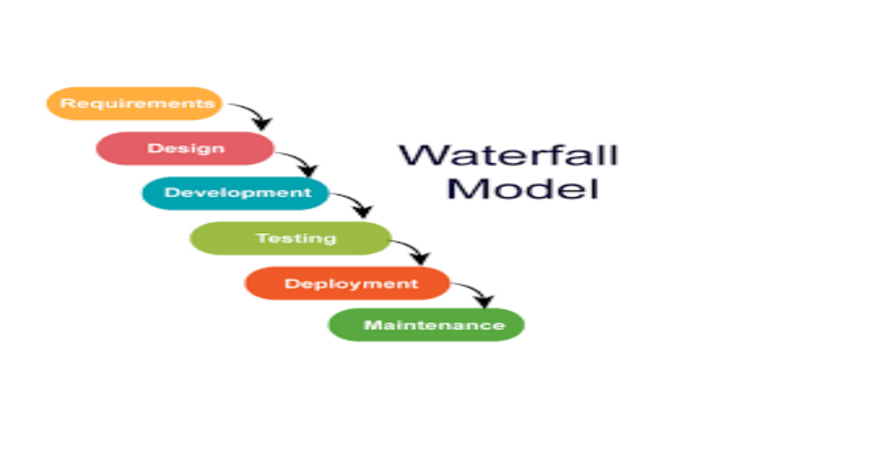

Slide 17
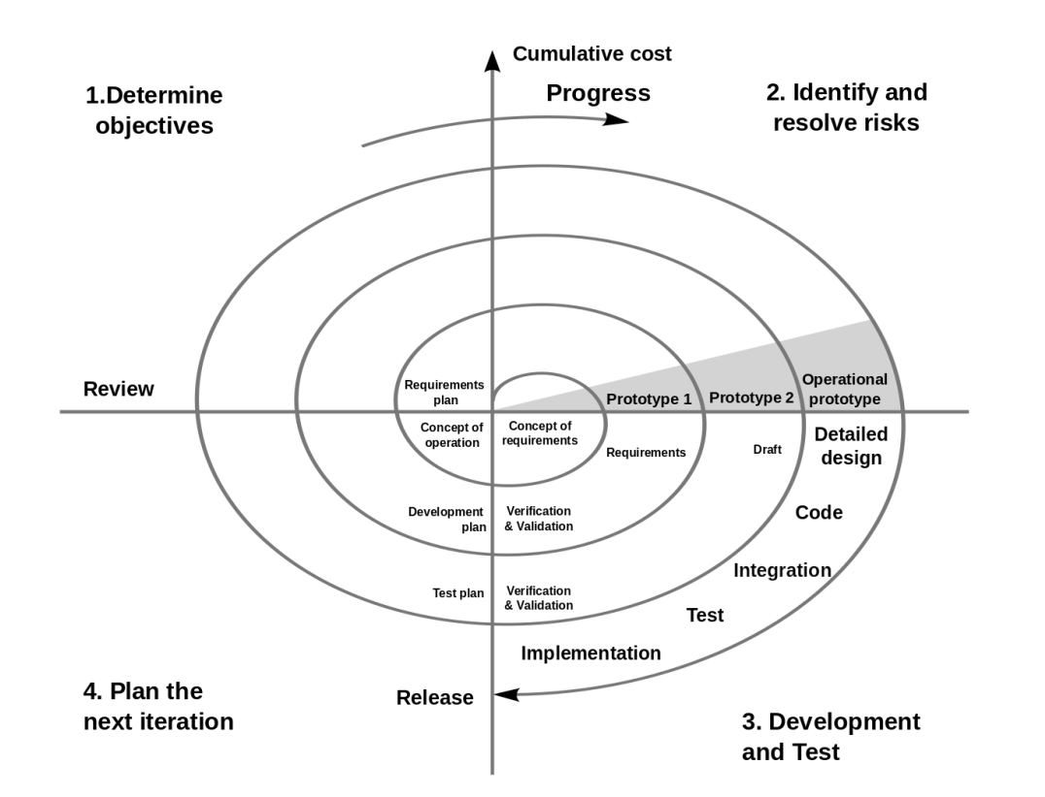
Spiral Model

Slide 18
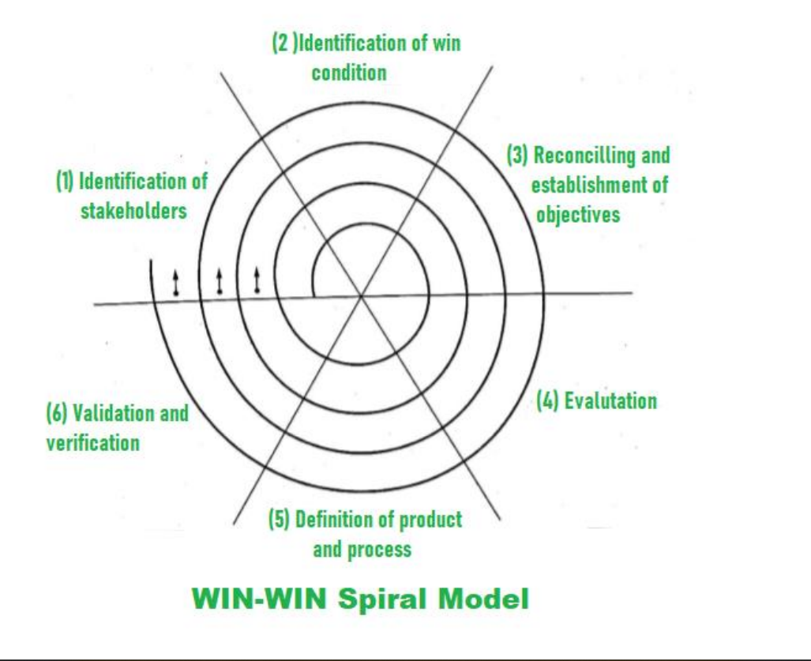

Slide 19
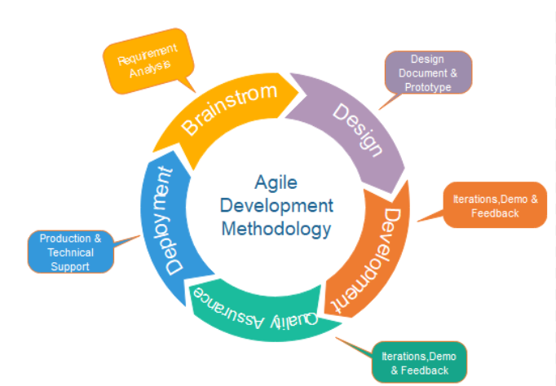
AGILE
Introduction and Types

Slide 20
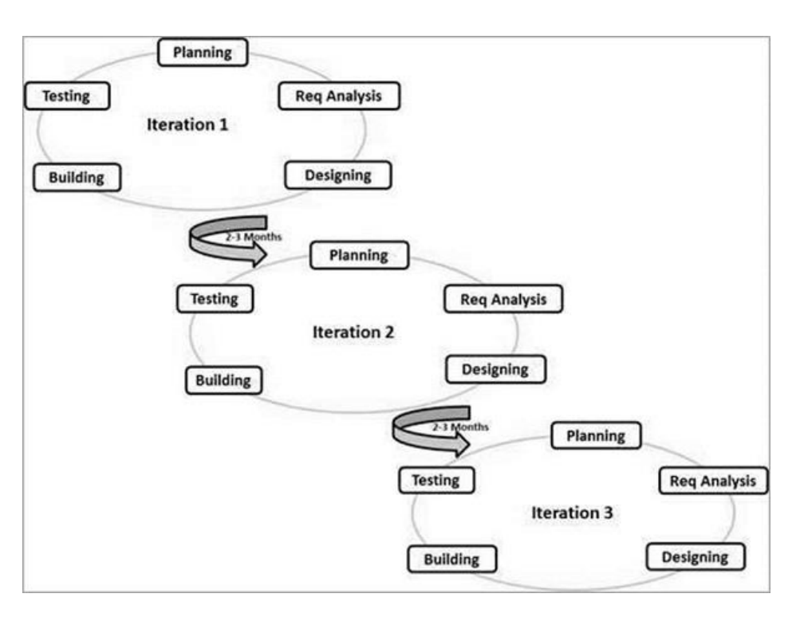
AGILE

Slide 21
Agile development model
Agile is a software development methodology to build a software incrementally using short iterations of 1 to 4 weeks so that the development process is aligned with the changing business needs. Instead of a single-pass development of 6 to 18 months where all the requirements and risks are predicted upfront, Agile adopts a process of frequent feedback where a workable product is delivered after 1 to 4-week iteration.

Slide 22
Different Agile Methodologies
Kanban
Originating from the Japanese language, the translation of the word ‘Kanban’ is “visual board or signboard” and is connected to the concept of “just in time”! Initially, the Kanban concept was introduced as a lean manufacturing system and slowly drove its way to agile software development teams. This method uses visual methods for developing and managing projects.
Projects through Kanban are overseen with the help of the Kanban Board, which is divided into columns to depict the process flow of the software development. This helps in increasing the visibility of teams as the teams can see the progress through every stage of development and prepare for the upcoming tasks to deliver the product “just in time”
This method requires thorough interaction and transparency to enable the team members to be equipped with the right stage of development at any time and have a cohesive flow of work at all times

Slide 23
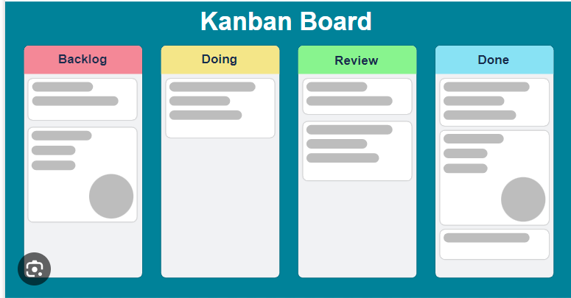

Slide 24
Different Agile Methodologies
Scrum
One of the most popular agile methodology examples is the agile scrum development methodology, which is depicted by various cycles of development. Similar to Kanban, Scrum breaks down the development phases into stages or cycles called ‘sprints’. The development time for each sprint is maximized and dedicated, thereby managing only one sprint at a time.
Scrum and agile methodologies focus on continuous deliverables, and thus this method lets designers adjust priorities to ensure that any incomplete or overdue sprints get more attention.
Scrum Team has exclusive project roles such as a scrum master and a product owner with constant communications on the daily scrum where the activities are harmonized to devise the best way to implement the sprint

Slide 25
Different Agile Methodologies
Extreme Programming(XP)
Extreme Programming (XP) is a methodology that emphasizes teamwork, communication, and feedback. It focuses on constant development and customer satisfaction. Similar to scrum, this method also uses sprints or short development cycles. This is developed by a team to create a productive and highly efficient environment.
The extreme Programming technique is very supportive in a situation of constant and varying demands from the customers. It motivates the developers to accept changes in the customer’s demands, even if they pop up in an advanced phase of the development process
In Extreme Programming, the project is tested from the initial stages by collecting feedback that progresses the output of the system. This also presents a spot check to implement easily any customer requirements

Slide 26
Crystal
Introduced by Mr Alistair Cockburn, one of the monumental persons in formulating the Agile manifesto for software development, Crystal is a group of smaller agile development methodologies comprising Crystal Yellow, Crystal Clear, Crystal Red, Crystal Orange, and more. Each has its peculiar and exclusive framework that is characterized by factors such as system criticality, team size, and project priorities. Depending on the nature of the project or system criticality such as Comfort (C), Essential Money (E), Discretionary Money (D), and Life (L), the kind of crystal agile methodology is chosen.
Similar to other methodologies of Agile, Crystal also addresses prompt delivery of software, regularity, less administration with high involvement of users, and customer satisfaction. The Crystal family advocates that each system or project is inimitable and necessitates the solicitation of diverse practices, processes, and policies to achieve the best results, earning the name of the most lightweight methods of agile methodology.

Slide 27
Dynamic Systems Development Method
To address the need for a standard industry charter for the swift delivery of software, the Dynamic Systems Development Method (DSDM) was developed. DSDM gives a comprehensive structure that is defined and modified to create a plan, execute, manage, and scale the procedure of software development. Based on a businessdriven approach and eight principles, the DSDM believes that modifications to the project are always expected, and quality with timely delivery must never be negotiated.

Slide 28
Feature-Driven Development
Several industry-recognized best practices are incorporated into this iterative, customer-centric, and incremental agile method. Its primary goal is to consistently produce working software in a timely fashion
Lifecycle stages include developing an overarching model of the project; creating feature lists; planning by feature; designing by feature; and finally building by feature. Using this five-step process, large project teams will be able to move their products forward at a steady pace

Slide 29
Lean Software Development
This agile methodology is based on seven principles:
• Deleting what doesn’t matter- Anything that doesn’t add value is removed from the project
• Quality development- The discipline and control of the number of residuals created are essential to quality development
• Knowledge creation- The team is driven to document the entire infrastructure to preserve this value in the future
• Defer commitments- This point encourages the team to focus less on planning and anticipating ideas without first having a prior and complete understanding of the business requirements
• Delivery promptly- Providing value to the customer as quickly as possible
• Respecting the team- two essential points are communication and conflict management
• Optimize the whole- To create a flow of true value, the development sequence must be perfected enough to remove errors from the code Using this lean methodology, development time and resources are optimized. This method is easily scalable and adaptable to projects of any size.

Slide 30
Scaled Agile Framework
A set of workflow and organizational patterns for implementing agile practices at an enterprise scale is known as the Scaled Agile Framework (SAFe). Adopting SAFe allows you to take advantage of a framework that is relatively light while still maintaining the centralized decision-making required at the enterprise level for software development efficiency. To put it another way, SAFe takes the agile philosophy and applies it to software executives who are tasked with addressing more strategic issues

Slide 31
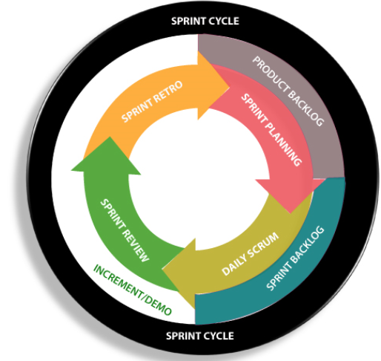
SCRUM Methodology

Slide 32
SCRUM
Scrum is a framework within which people can address complex adaptive problems, while productively and creatively delivering products of the highest possible value. Scrum is a process framework that has been used to manage complex product development since the early 1990s.
Scrum is not a process or a technique for building products; rather, it is a framework within which you can employ various processes and techniques. Scrum makes clear the relative efficacy of your product management and development practices so that you can improve.
The Scrum framework consists of Scrum Teams and their associated roles, events, artifacts, and rules. Each component within the framework serves a specific purpose and is essential to Scrum’s success and usage
The rules of Scrum bind together the events, roles, and artifacts, governing the relationships and interaction between them.

Slide 33
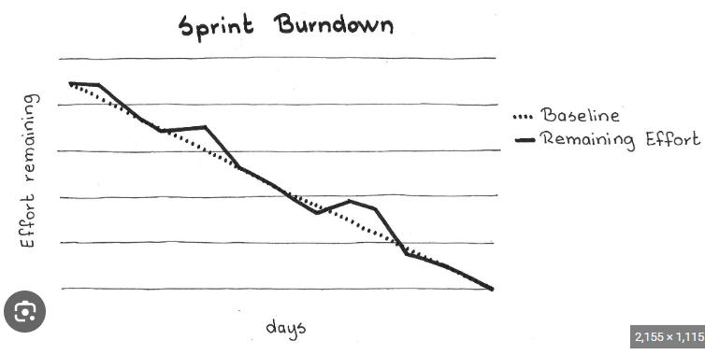

Slide 34
Working with JIRA
Sign up with JIRA Application
Create a project
Select template(scrum or other methodologies)
Create Epic ,backlog and sprint

Slide 35


Thank Yo
Sailesh Padmanabhan
Arjun_Sailesh@yahoo.com

